Slide 1
PASTEURISATION UPGRADE
LEAL

Slide 2
Security Measures

Slide 3
BOTTLE JAM :
Incase of Bottle Jam in Outfeed , the Main drive will stop After the time set by the operator
PUMPS I/L Time :
In case the temperature is lower than set for more than mentioned time , the Main Drive will Stop
NOTE : Both Temperature variation and Time limit of mismatch can be set
Interlock Time :
If Main Drive Stops for more than Set Time , the Spraying Pumps will turn off and Will enter to PU Limiting Mode , Where temperature of the Pasteuriser Zone is brought down to user defined Temperature as emergency Set Temp for that zone alone . Other Spray Pumps will be off during this Time period
Log on :
Only 2 users can alter the Set Temperatures which needs Password.

Slide 4
LOGGING

Slide 5
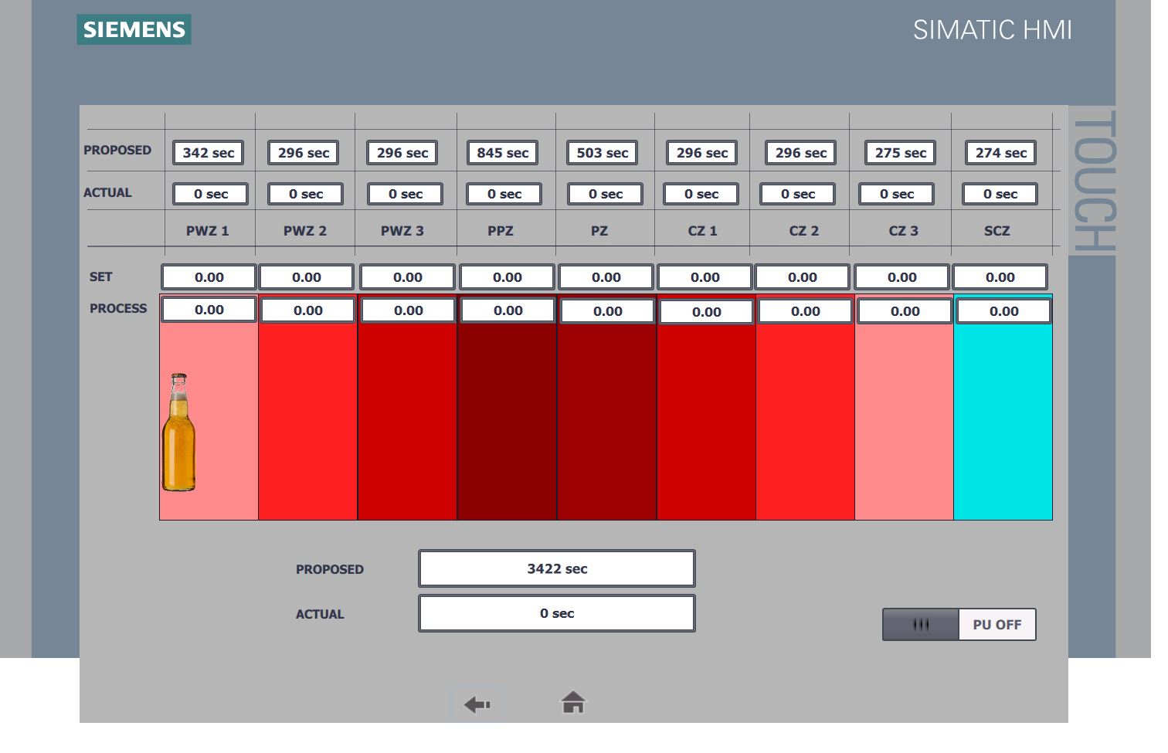
LOGGING :
-The Temperature Values of individual Zones will be logged with a time interval of 1 min and stored up to 30 days which can be manually saved and accessed via USB and viewed in Excel
- PU and Main Drive run time values will be logged after enabling them in HMI

Slide 6
GRAPH
Graph Can Be viewed in HMI for individual zones . Screenshot of the same can be viewed & stored in an USB Device

